Slide 1
COMP 590-154: Computer Architecture
Multi-{Socket,Core,Thread}

Slide 2
Getting More Performance
Keep pushing IPC and/or frequenecy
Design complexity (time to market)
Cooling (cost)
Power delivery (cost)
…
Possible, but too costly

Slide 3
Bridging the Gap
Watts /
IPC
Power has been growing
exponentially as well
100
10
1
Diminishing returns w.r.t.
larger instruction window,
higher issue-width
Single-Issue
Pipelined
Superscalar
Out-of-Order
(Today)
Superscalar
Out-of-Order
(Hypothetical-
Aggressive)
Limits

Slide 4
Higher Complexity not Worth Effort
Performance
Made sense to go
Superscalar/OOO:
good ROI
Very little gain for
substantial effort
“Effort”
Scalar
In-Order
Moderate-Pipe
Superscalar/OOO
Very-Deep-Pipe
Aggressive
Superscalar/OOO

Slide 5
User Visible/Invisible
All performance gains up to this point were “free”
No user intervention required (beyond buying new chip)
Recompilation/rewriting could provide even more benefit
Higher frequency & higher IPC
Same ISA, different micro-architecture
Multi-processing pushes parallelism above ISA
Coarse grained parallelism
Provide multiple processing elements
User (or developer) responsible for finding parallelism
User decides how to use resources

Slide 6
Sources of (Coarse) Parallelism
Different applications
MP3 player in background while you work in Office
Other background tasks: OS/kernel, virus check, etc…
Piped applications
gunzip -c foo.gz | grep bar | perl some-script.pl
Threads within the same application
Java (scheduling, GC, etc...)
Explicitly coded multi-threading
pthreads, MPI, etc…

Slide 7
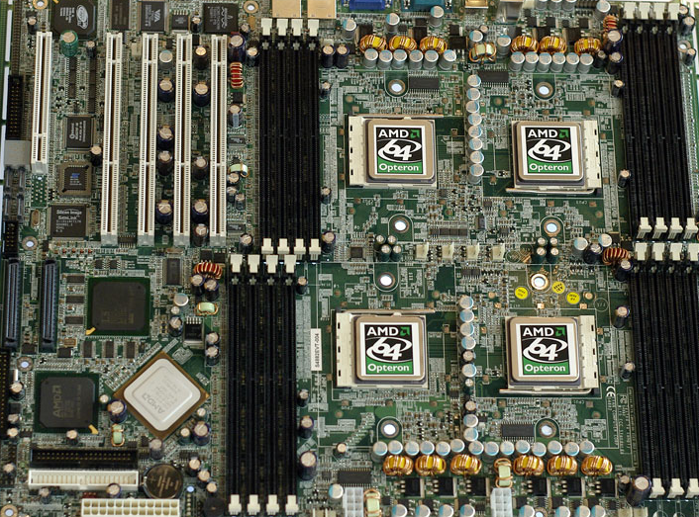
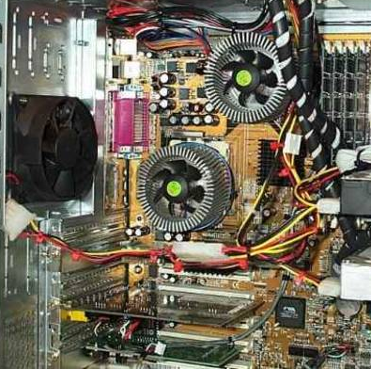
SMP Machines
SMP = Symmetric Multi-Processing
Symmetric = All CPUs have “equal” access to memory
OS sees multiple CPUs
Runs one process (or thread) on each CPU
CPU₀
CPU₁
CPU₂
CPU₃

Slide 8
MP Workload Benefits
runtime
Task A
Task B
3-wide
OOO
CPU
4-wide
OOO
CPU
Task A
Task B
Benefit
3-wide
OOO
CPU
3-wide
OOO
CPU
Task A
Task B
Task A
2-wide
OOO
CPU
2-wide
OOO
CPU
Task B
Assumes you have multiple tasks/programs to run
Notes:
Just showing that with parallelism, even two “smaller” cores may provide better overall performance than one “regular” core (and the smaller cores are likely to be cheaper from an area and power standpoint due to how these tend to grow super-linearly).

Slide 9
… If Only One Task Available
runtime
Task A
3-wide
OOO
CPU
4-wide
OOO
CPU
Task A
Benefit
3-wide
OOO
CPU
3-wide
OOO
CPU
Task A
No benefit over 1 CPU
Task A
2-wide
OOO
CPU
2-wide
OOO
CPU
Performance
degradation!
Idle
Notes:
But you’re stuck if you care about single-thread performance

Slide 10
Benefit of MP Depends on Workload
Limited number of parallel tasks to run
Adding more CPUs than tasks provides zero benefit
For parallel code, Amdahl’s law curbs speedup
parallelizable
1CPU
2CPUs
3CPUs
4CPUs

Slide 11
Hardware Modifications for SMP
Processor
Memory interface
Motherboard
Multiple sockets (one per CPU)
Datapaths between CPUs and memory
Other
Case: larger (bigger motherboard, better airflow)
Power: bigger power supply for N CPUs
Cooling: more fans to remove N CPUs worth of heat

Slide 12
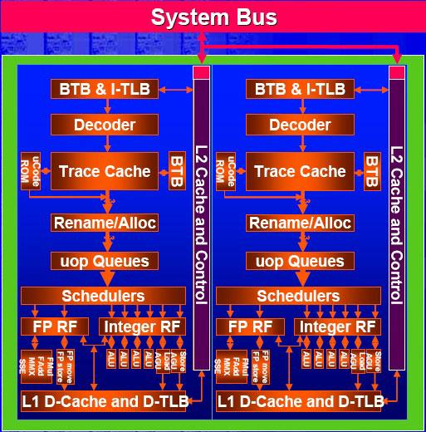
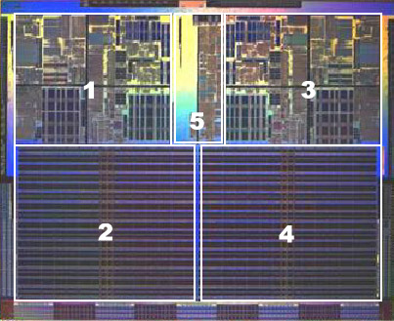
Chip-Multiprocessing (CMP)
Simple SMP on the same chip
CPUs now called “cores” by hardware designers
OS designers still call these “CPUs”
Intel “Smithfield” Block Diagram
AMD Dual-Core Athlon FX

Slide 13
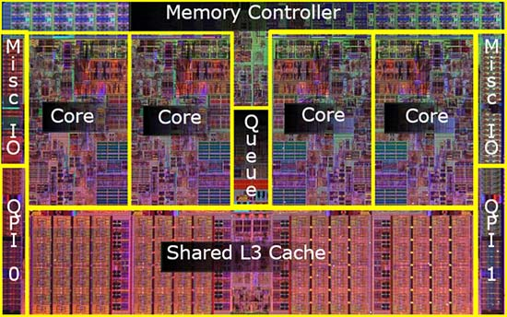
On-chip Interconnects (1/5)
Today, (Core+L1+L2) = “core”
(L3+I/O+Memory) = “uncore”
How to interconnect multiple “core”s to “uncore”?
Possible topologies
Bus
Crossbar
Ring
Mesh
Torus
Core
Core
Core
Core
$
$
$
$
LLC $
Memory
Controller

Slide 14
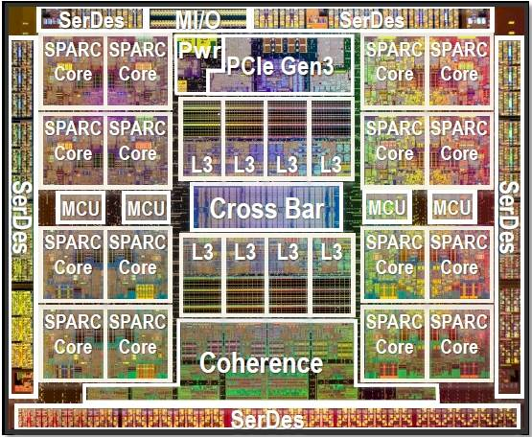
On-chip Interconnects (2/5)
Possible topologies
Bus
Crossbar
Ring
Mesh
Torus
Core
Core
Core
Core
$
$
$
$
$
Bank 0
$
Bank 1
$
Bank 2
$
Bank 3
Oracle UltraSPARC T5 (3.6GHz, 16 cores, 8 threads per core)
Memory
Controller

Slide 15
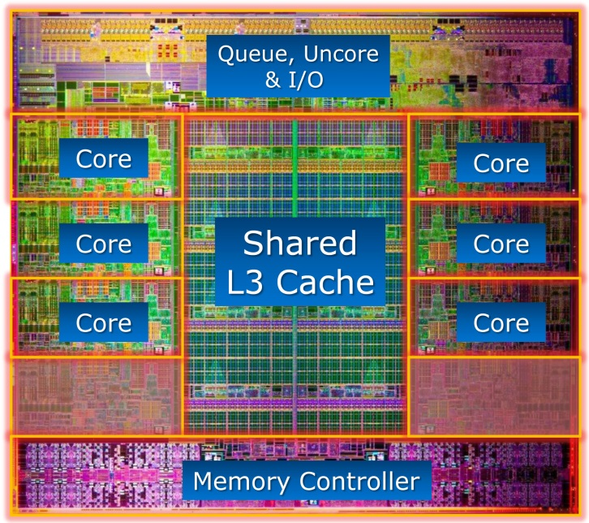
On-chip Interconnects (3/5)
Possible topologies
Bus
Crossbar
Ring
Mesh
Torus
Core
Core
Core
Core
$
$
$
$
Memory
Controller
$
Bank 0
$
Bank 1
$
Bank 2
$
Bank 3
3 ports per switch
Simple and cheap
Can be bi-directional to reduce latency
Intel Sandy Bridge (3.5GHz, 6 cores, 2 threads per core)

Slide 16
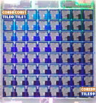
On-chip Interconnects (4/5)
Possible topologies
Bus
Crossbar
Ring
Mesh
Torus
Core
Core
$
$
Memory
Controller
$
Bank 0
$
Bank 1
Core
Core
Core
$
$
$
$
Bank 2
$
Bank 3
$
Bank 4
Core
Core
Core
$
$
$
$
Bank 5
$
Bank 6
$
Bank 7
Tilera Tile64 (866MHz, 64 cores)
Up to 5 ports per switch
Tiled organization combines core and cache

Slide 17
On-chip Interconnects (5/5)
Possible topologies
Bus
Crossbar
Ring
Mesh
Torus
5 ports per switch
Can be “folded” to avoid long links
Core
Core
$
$
Memory
Controller
$
Bank 0
$
Bank 1
Core
Core
Core
$
$
$
$
Bank 2
$
Bank 3
$
Bank 4
Core
Core
Core
$
$
$
$
Bank 5
$
Bank 6
$
Bank 7

Slide 18
Benefits of CMP
Cheaper than multi-chip SMP
All/most interface logic integrated on chip
Fewer chips
Single CPU socket
Single interface to memory
Less power than multi-chip SMP
Communication on die uses less power than chip to chip
Efficiency
Use for transistors instead of wider/more aggressive OoO
Potentially better use of hardware resources

Slide 19
CMP Performance vs. Power
2x CPUs not necessarily equal to 2x performance
2x CPUs → ½ power for each
Maybe a little better than ½ if resources can be shared
Back-of-the-Envelope calculation:
3.8 GHz CPU at 100W
Dual-core: 50W per Core
P ∝ V³: V_{orig}³/V_{CMP}³ = 100W/50W → V_{CMP} = 0.8 V_{orig}
f ∝ V: f_{CMP} = 3.0GHz
Notes:
For a multi-threaded application, two 3.0GHz cores is probably better than one 3.8Ghz core.

Slide 20
Multi-Threading
Uni-Processor: 4-6 wide, lucky if you get 1-2 IPC
Poor utilization of transistors
SMP: 2-4 CPUs, but need independent threads
Poor utilization as well (if limited tasks)
{Coarse-Grained,Fine-Grained,Simultaneous}-MT
Use single large uni-processor as a multi-processor
Core provide multiple hardware contexts (threads)
Per-thread PC
Per-thread ARF (or map table)
Each core appears as multiple CPUs
OS designers still call these “CPUs”

Slide 21
Scalar Pipeline
Time
Dependencies limit functional unit utilization
Notes:
To motivate how we came to incorporate multithreading into EV8, let’s return to the early 1980’s and take a very high level view of instruction execution.
This very abstract diagram illustrates the activity in just the execute stage of a single issue machine, with the red boxes showing instruction execution.
Note gaps due to multiple cycle operation latency and inter-instruction dependencies which result in less than perfect utilization of the function units.

Slide 22
Superscalar Pipeline
Time
Higher performance than scalar, but lower utilization
Notes:
If that weren’t bad enough, for more performance we now make parallel (or wide) issue to use more function units in a cycle.
Even with sophisticated techniques like out-of-order (or dynamic) issue, and sophisticated branch prediction, this leads to more waste, since there aren’t always enough instructions to issue in a cycle.
Peak sustainable execution rate – 21264 = 4, a wide variety of studies have shown this function unit unitization to be under 50%, and getting worse as machines continue to get wider.
Note I’m not saying that its bad to keep on this trajectory, because continuing to make the machine wider is still providing an absolute single stream performance benefit. Furthermore the key point is not keeping FUs busy, because they really aren’t that expensive, but because they represent more work getting done.
So what can we do….

Slide 23
Chip Multiprocessing (CMP)
Time
Limited utilization when running one thread
Notes:
Another approach is to get more efficiency by using two smaller CPUs. But this sacrifices single stream performance. And Amdahl’s law tells us that sometimes you have parallelism and sometimes you don’t so one can’t always use multiple streams. This just means you still will see reduced function unit utilization.

Slide 24
Coarse-Grained Multithreading (1/3)
Time
Hardware Context Switch
Only good for long latency ops (i.e., cache misses)
Notes:
Another approach is to get more efficiency by using two smaller CPUs. But this sacrifices single stream performance. And Amdahl’s law tells us that sometimes you have parallelism and sometimes you don’t so one can’t always use multiple streams. This just means you still will see reduced function unit utilization.

Slide 25
Coarse-Grained Multithreading (2/3)
Sacrifices a little single thread performance
Tolerates only long latencies (e.g., L2 misses)
Thread scheduling policy
Designate a “preferred” thread (e.g., thread A)
Switch to thread B on thread A L2 miss
Switch back to A when A L2 miss returns
Pipeline partitioning
None, flush on switch
Can’t tolerate latencies shorter than twice pipeline depth
Need short in-order pipeline for good performance

Slide 26
Coarse-Grained Multithreading (3/3)
original pipeline
regfile
I$
D$
B
P
thread scheduler
regfile
regfile
I$
D$
B
P
L2 miss?

Slide 27
Fine-Grained Multithreading (1/3)
Time
Saturated workload → Lots of threads
Unsaturated workload → Lots of stalls
Intra-thread dependencies still limit performance
Notes:
Classic answer to problem of dependencies is to take instructions from multiple threads.
Still leaves a lot of wasted slots. Some varients of this style of multthreading result in a design where where every thread goes much slower.
I actually worked on this style of multithreading for my Ph.D ages ago, but had abandoned the idea until now.

Slide 28
Fine-Grained Multithreading (2/3)
Sacrifices significant single-thread performance
Tolerates everything
L2 misses
Mispredicted branches
etc...
Thread scheduling policy
Switch threads often (e.g., every cycle)
Use round-robin policy, skip threads with long-latency ops
Pipeline partitioning
Dynamic, no flushing
Length of pipeline doesn’t matter

Slide 29
Fine-Grained Multithreading (3/3)
(Many) more threads
Multiple threads in pipeline at once
regfile
thread scheduler
regfile
regfile
regfile
I$
D$
B
P

Slide 30
Simultaneous Multithreading (1/3)
Time
Max utilization of functional units
Notes:
What changed my mind was the work by Dean Tullsen at U. Washington who addressed waste issue, by proposing simultaneous multithreading.
What he suggested was simply using any available slot for any available thread.
But his work was somewhat incomplete, so we then collaborated to work on achieving the goal of uncompromsed single stream performance - and multithreading...

Slide 31
Simultaneous Multithreading (2/3)
Tolerates all latencies
Sacrifices some single thread performance
Thread scheduling policy
Round-robin (like Fine-Grained MT)
Pipeline partitioning
Dynamic
Examples
Pentium4 (hyper-threading): 5-way issue, 2 threads
Alpha 21464: 8-way issue, 4 threads (canceled)

Slide 32
Simultaneous Multithreading (3/3)
original pipeline
map table
regfile
I$
D$
B
P
thread scheduler
map tables
regfile
I$
D$
B
P

Slide 33
Issues for SMT
Cache interference
Concern for all MT variants
Shared memory SPMD threads help here
Same insns. → share I$
Shared data → less D$ contention
MT is good for “server” workloads
SMT might want a larger L2 (which is OK)
Out-of-order tolerates L1 misses
Large map table and physical register file
#maptable-entries = (#threads * #arch-regs)
#phys-regs = (#threads * #arch-regs) + #in-flight insns

Slide 34
Latency vs. Throughput
MT trades (single-thread) latency for throughput
Sharing processor degrades latency of individual threads
But improves aggregate latency of both threads
Improves utilization
Example
Thread A: individual latency=10s, latency with thread B=15s
Thread B: individual latency=20s, latency with thread A=25s
Sequential latency (first A then B or vice versa): 30s
Parallel latency (A and B simultaneously): 25s
MT slows each thread by 5s
But improves total latency by 5s
Benefits of MT depend on workload

Slide 35
CMP vs. MT
If you wanted to run multiple threads would you build a…
Chip multiprocessor (CMP): multiple separate pipelines?
A multithreaded processor (MT): a single larger pipeline?
Both will get you throughput on multiple threads
CMP will be simpler, possibly faster clock
SMT will get you better performance (IPC) on a single thread
SMT is basically an ILP engine that converts TLP to ILP
CMP is mainly a TLP engine
Do both (CMP of MTs), Example: Sun UltraSPARC T1
8 processors, each with 4-threads (fine-grained threading)
1Ghz clock, in-order, short pipeline
Designed for power-efficient “throughput computing”

Slide 36
Combining MP Techniques (1/2)
System can have SMP, CMP, and SMT at the same time
Example machine with 32 threads
Use 2-socket SMP motherboard with two chips
Each chip with an 8-core CMP
Where each core is 2-way SMT
Makes life difficult for the OS scheduler
OS needs to know which CPUs are…
Real physical processor (SMP): highest independent performance
Cores in same chip: fast core-to-core comm., but shared resources
Threads in same core: competing for resources
Distinct apps. scheduled on different CPUs
Cooperative apps. (e.g., pthreads) scheduled on same core
Use SMT as last choice (or don’t use for some apps.)

Slide 37
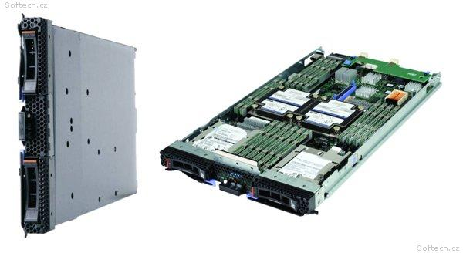
Combining MP Techniques (2/2)

Slide 38
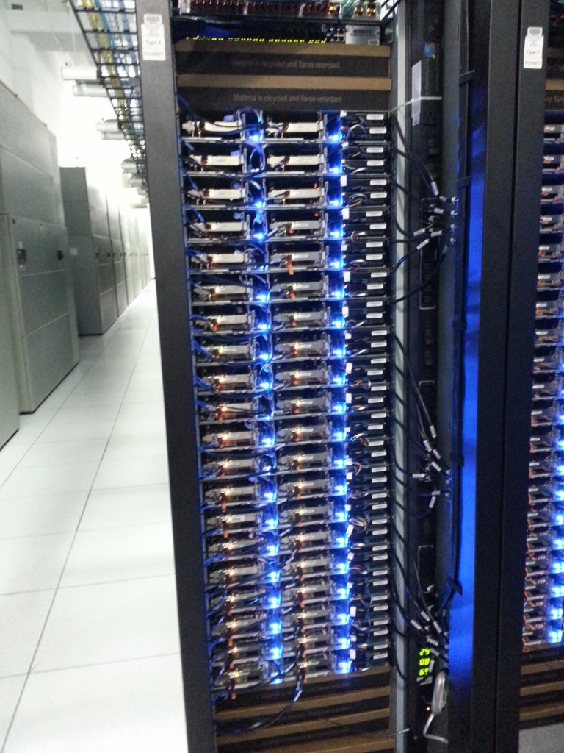
Scalability Beyond the Machine

Slide 39

Server Racks

Slide 40
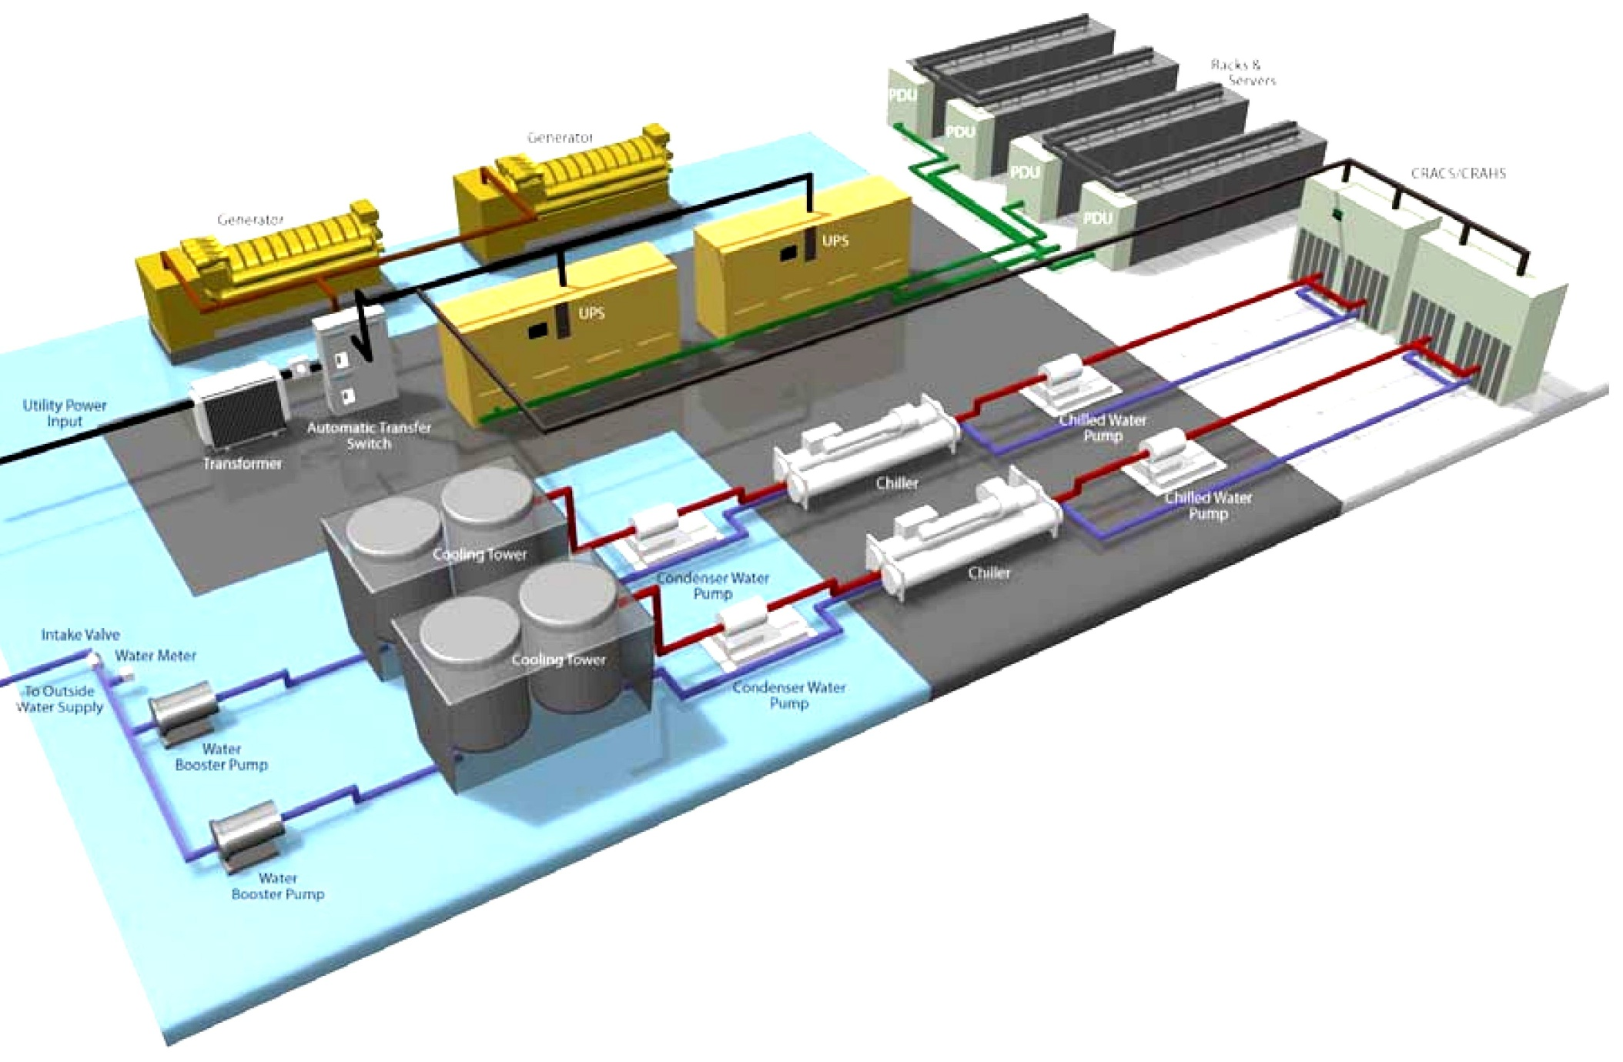
Datacenters (1/3)

Slide 41
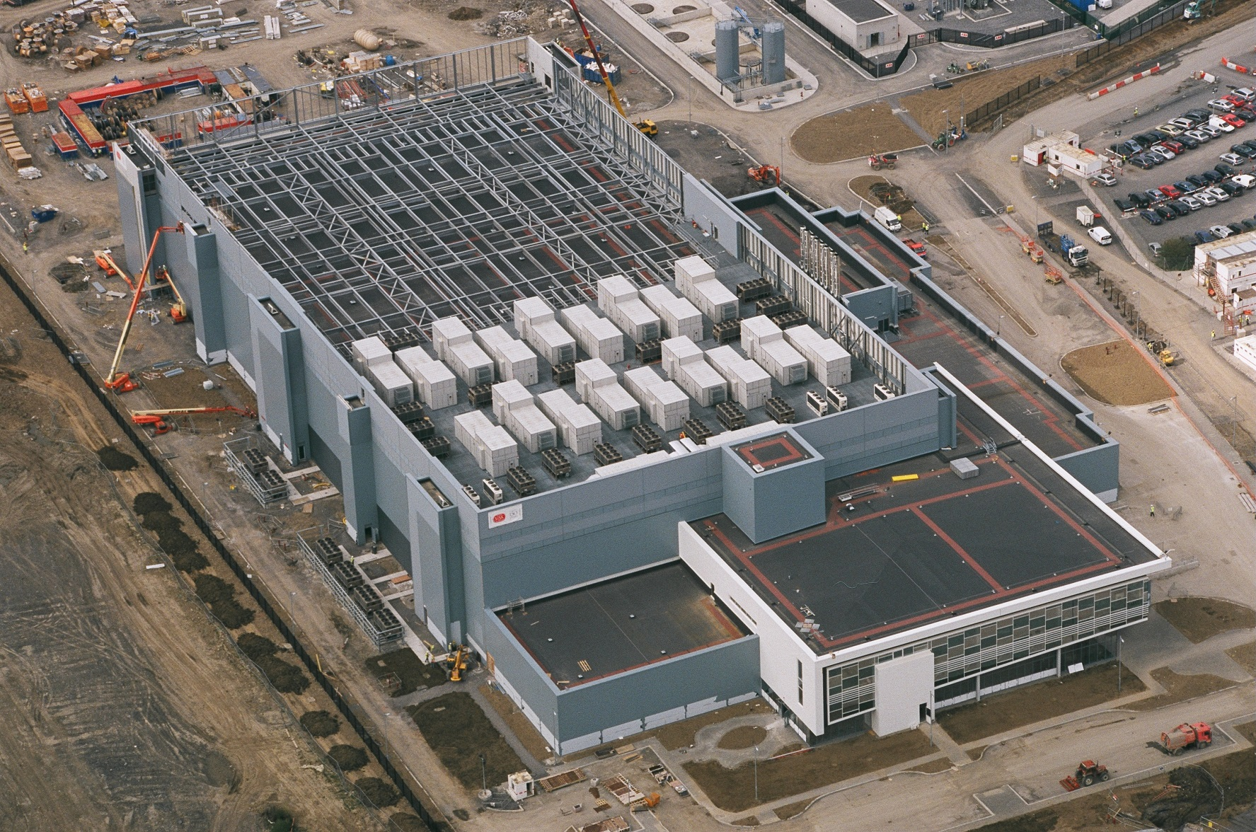
Datacenters (2/3)

Slide 42
Datacenters (3/3)

